Slide 1
Independence
Recall that two random variables are independent if the following holds:
$P\left(A, B\right)=P\left(A\right) P(B)$

Slide 2
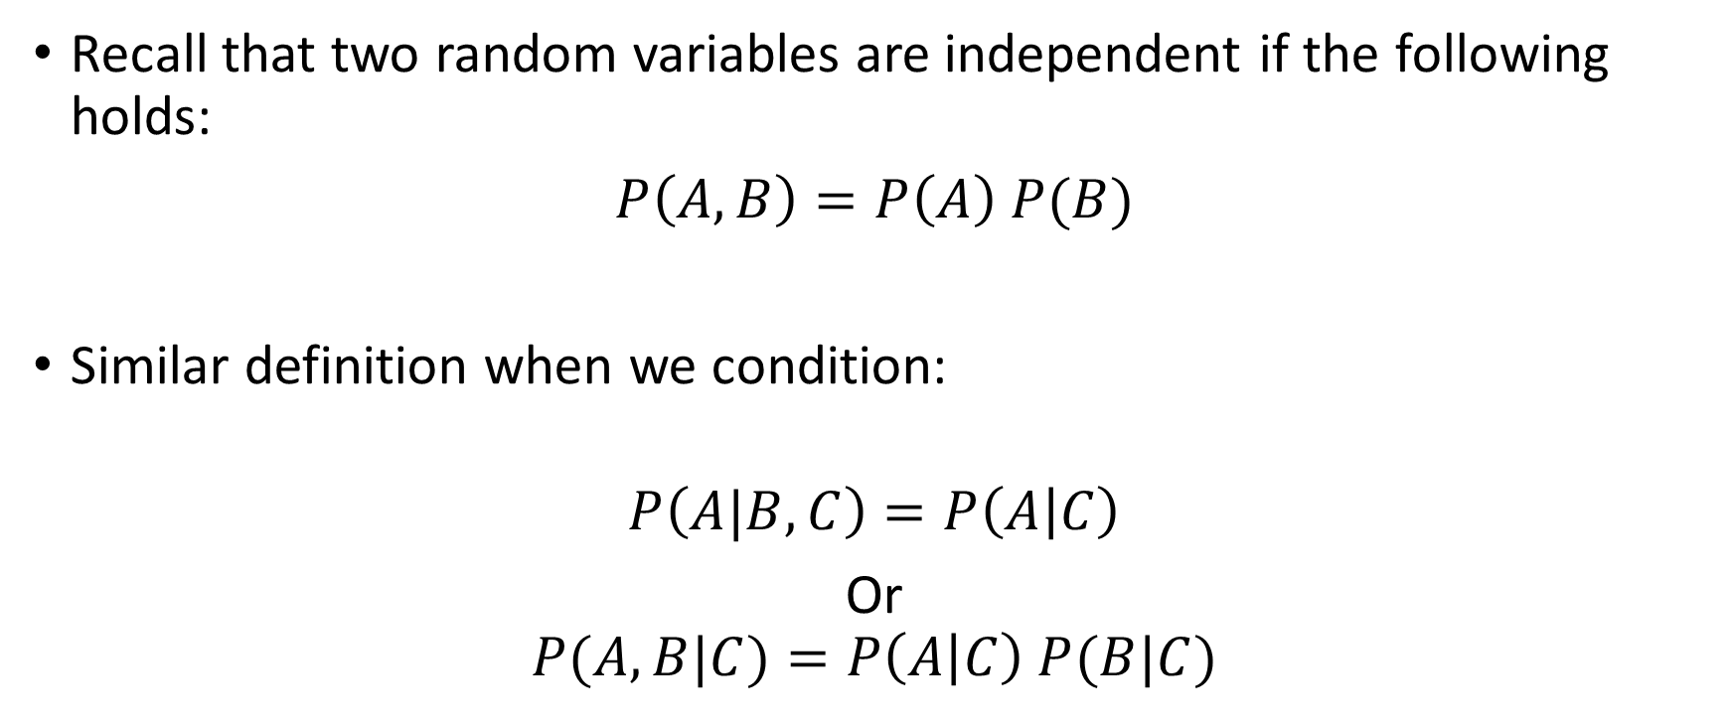
Conditional Independence
Recall that two random variables are independent if the following holds:
$P\left(A, B\right)=P\left(A\right) P(B)$
Similar definition when we condition:
$$P\left(A|B,C\right)=P\left(A | C\right)$$
Or
$$P(A,B|C)=P\left(A | C\right) P(B|C)$$

Slide 3
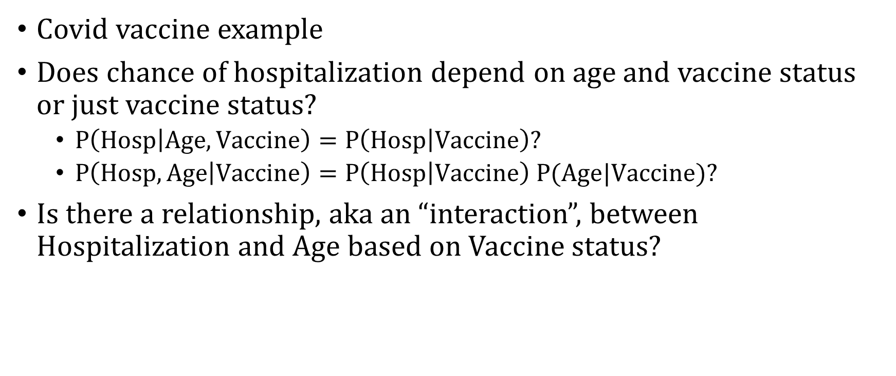
Conditional Independence Intuition
Covid vaccine example
Does chance of hospitalization depend on age and vaccine status or just vaccine status?
$P\left(Hosp | Age, Vaccine\right)=P\left(Hosp | Vaccine\right)?$
$P\left(Hosp,Age | Vaccine\right)=P\left(Hosp | Vaccine\right) P(Age|Vaccine)?$
Is there a relationship, aka an “interaction”, between Hospitalization and Age based on Vaccine status?

Slide 4
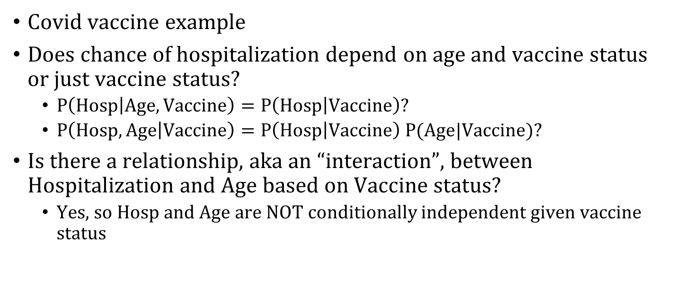
Conditional Independence Intuition
Covid vaccine example
Does chance of hospitalization depend on age and vaccine status or just vaccine status?
$P\left(Hosp | Age, Vaccine\right)=P\left(Hosp | Vaccine\right)?$
$P\left(Hosp,Age | Vaccine\right)=P\left(Hosp | Vaccine\right) P(Age|Vaccine)?$
Is there a relationship, aka an “interaction”, between Hospitalization and Age based on Vaccine status?
Yes, so Hosp and Age are NOT conditionally independent given vaccine status

Slide 5
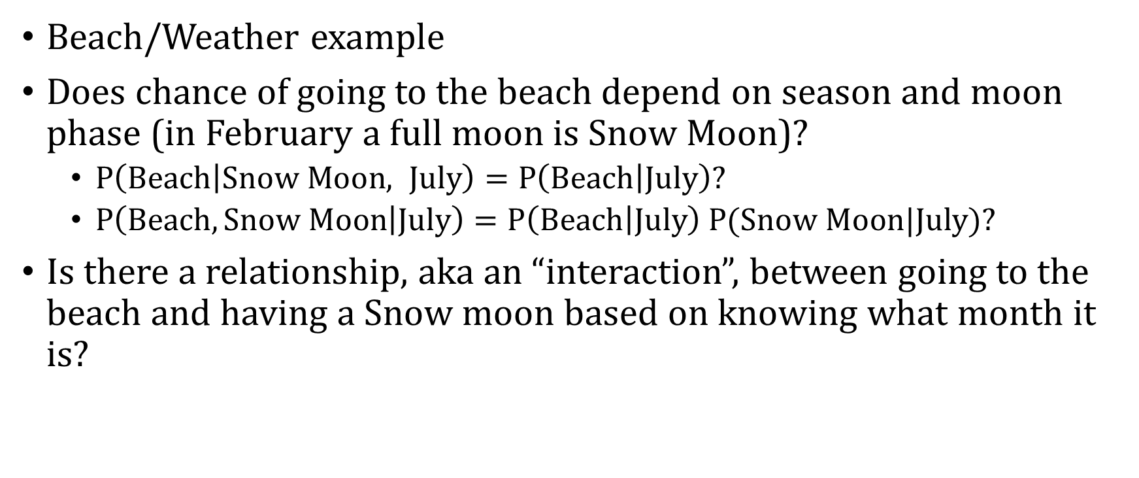
Conditional Independence Intuition
Beach/Weather example
Does chance of going to the beach depend on season and moon phase (in February a full moon is Snow Moon)?
$P\left(Beach | Snow Moon, July\right)=P\left(Beach | July\right)?$
$P\left(Beach,Snow Moon | July\right)=P\left(Beach | July\right) P(Snow Moon|July)?$
Is there a relationship, aka an “interaction”, between going to the beach and having a Snow moon based on knowing what month it is?

Slide 6
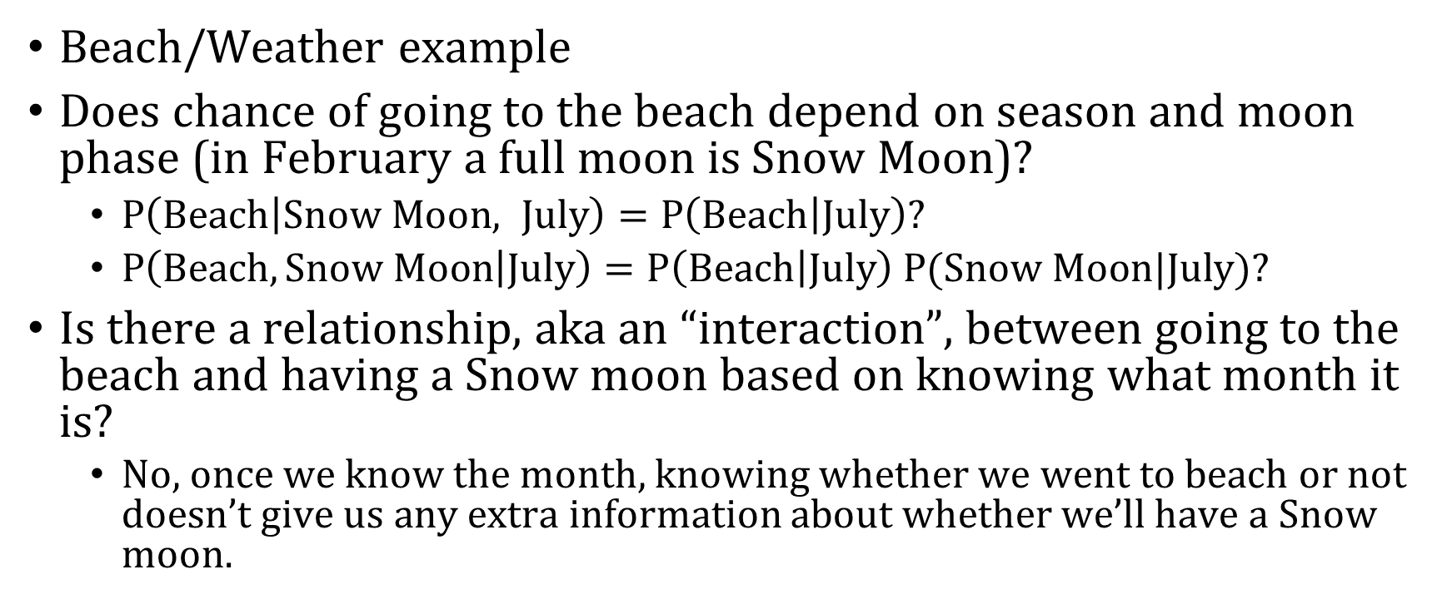
Conditional Independence Intuition
Beach/Weather example
Does chance of going to the beach depend on season and moon phase (in February a full moon is Snow Moon)?
$P\left(Beach | Snow Moon, July\right)=P\left(Beach | July\right)?$
$P\left(Beach,Snow Moon | July\right)=P\left(Beach | July\right) P(Snow Moon|July)?$
Is there a relationship, aka an “interaction”, between going to the beach and having a Snow moon based on knowing what month it is?
No, once we know the month, knowing whether we went to beach or not doesn’t give us any extra information about whether we’ll have a Snow moon.

Slide 7
Naïve Bayes Assumption
$$P\left(Y=1 | X_{1}=1,X_{2}=1\right)=\frac{P\left(X_{1}=1, X_{2}=1 | Y=1\right) P(Y=1)}{P(X_{1}=1,X_{2}=1)}$$

Slide 8
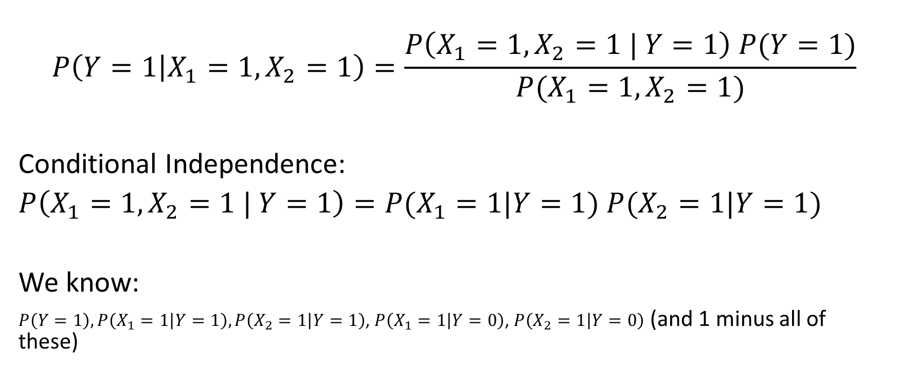
Naïve Bayes Assumption
$$P\left(Y=1 | X_{1}=1,X_{2}=1\right)=\frac{P\left(X_{1}=1, X_{2}=1 | Y=1\right) P(Y=1)}{P(X_{1}=1,X_{2}=1)}$$
Conditional Independence:
$P\left(X_{1}=1, X_{2}=1 | Y=1\right)=P(X_{1}=1|Y=1)$ $P(X_{2}=1|Y=1)$
We know:
$P\left(Y=1\right), P\left(X_{1}=1 | Y=1\right),P\left(X_{2}=1 | Y=1\right)$, $P\left(X_{1}=1 | Y=0\right)$, $P\left(X_{2}=1 | Y=0\right)$ (and 1 minus all of these)

Slide 9
Let’s Compute $P\left(Y=1 | X_{1}=1,X_{2}=1\right)$
$$P\left(Y=1 | X_{1}=1,X_{2}=1\right)=\frac{P\left(X_{1}=1, X_{2}=1 , Y=1\right)}{P(X_{1}=1,X_{2}=1)}$$
$$P\left(Y=1 | X_{1}=1,X_{2}=1\right)=\frac{P\left(X_{1}=1, X_{2}=1 | Y=1\right) P(Y=1)}{P(X_{1}=1,X_{2}=1)}$$
$$P\left(Y=1 | X_{1}=1,X_{2}=1\right)=\frac{P\left(X_{1}=1\left|Y=1\right)P(X_{2}=1 | Y=1\right) P(Y=1)}{P(X_{1}=1,X_{2}=1)}$$

Slide 10
Let’s Compute $P\left(Y=1 | X_{1}=1,X_{2}=1\right)$
$$P\left(Y=1 | X_{1}=1,X_{2}=1\right)=\frac{P\left(X_{1}=1\left|Y=1\right)P(X_{2}=1 | Y=1\right) P(Y=1)}{P(X_{1}=1,X_{2}=1)}$$
$P\left(Y=1 | X_{1}=1,X_{2}=1\right)=\frac{0.25 ∗0.3 ∗0.05}{P(X_{1}=1,X_{2}=1)}=\frac{0.00375}{P(X_{1}=1, X_{2}=2)}$

Slide 11
Let’s Compute $P\left(Y=1 | X_{1}=1,X_{2}=1\right)$
$$P\left(Y=1 | X_{1}=1,X_{2}=1\right)=\frac{P\left(X_{1}=1\left|Y=1\right)P(X_{2}=1 | Y=1\right) P(Y=1)}{P(X_{1}=1,X_{2}=1)}$$
$P\left(Y=1 | X_{1}=1,X_{2}=1\right)=\frac{0.25 ∗0.3 ∗0.05}{P(X_{1}=1,X_{2}=1)}=\frac{0.00375}{P(X_{1}=1, X_{2}=2)}$
But what if $P\left(Y=1 | X_{1}=1,X_{2}=1\right)<P\left(Y=0 | X_{1}=1,X_{2}=1\right)$?

Slide 12
Let’s Compute $P\left(Y=0 | X_{1}=1,X_{2}=1\right)$
$$P\left(Y=0 | X_{1}=1,X_{2}=1\right)=\frac{P\left(X_{1}=1\left|Y=0\right)P(X_{2}=1 | Y=0\right) P(Y=0)}{P(X_{1}=1,X_{2}=1)}$$
$P\left(Y=0 | X_{1}=1,X_{2}=1\right)=\frac{0.05 ∗0.1 ∗0.95}{P(X_{1}=1,X_{2}=1)}=\frac{0.00475}{P(X_{1}=1, X_{2}=2)}$

Slide 13
What’s our decision rule?
$\frac{.00375}{P\left(X_{1}=1,X_{2}=1\right)} \text{vs}\text{.} \frac{.00475}{P\left(X_{1}=1,X_{2}=1\right)}$

Slide 14
What’s our decision rule?
$\frac{.00375}{P\left(X_{1}=1,X_{2}=1\right)} \text{vs}\text{.} \frac{.00475}{P\left(X_{1}=1,X_{2}=1\right)}$

Slide 15
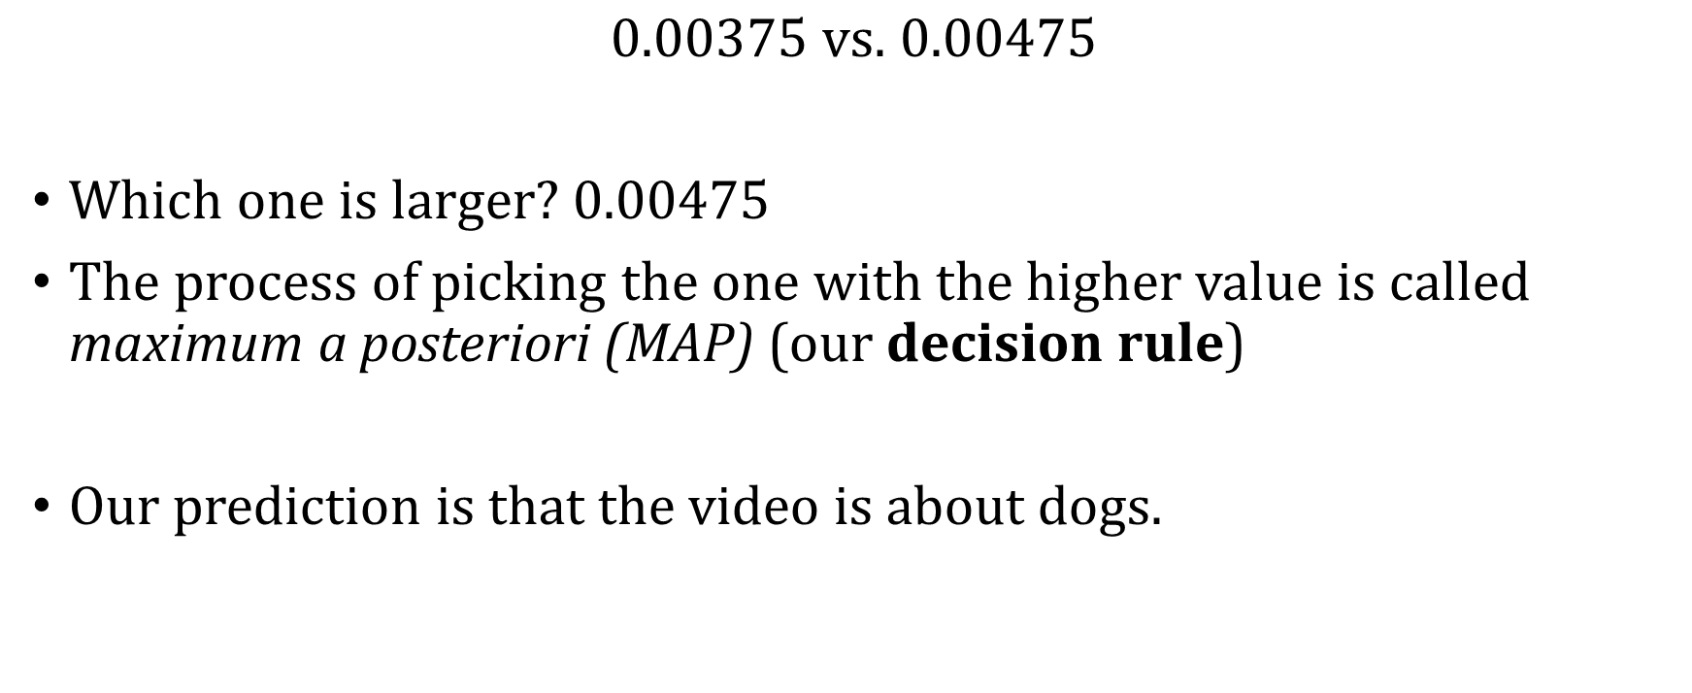
What’s our decision rule?
$0.00375 \text{vs}\text{.} 0.00475$
Which one is larger? 0.00475
The process of picking the one with the higher value is called maximum a posteriori (MAP) (our decision rule)
Our prediction is that the video is about dogs.

